Slide 1

Microprogrammed control: microinstruction
Computer Organization and Architecture | Hardwired and Microprogrammed Control
Course: Computer Organization and Architecture | Chapter: Hardwired and Microprogrammed Control | Program: Bachelor of Engineering
DISCOVER · LEARN · EMPOWER
Notes:
Welcome everyone to today's lecture on Microprogrammed Control. We are diving deep into the microinstruction, the fundamental building block of this control method. This topic is critical for understanding how modern processors execute complex machine instructions efficiently. Let us begin by mapping our learning outcomes to the course goals.

Slide 2
Course Outcomes
SLIDE 2 / 10
Course Outcome
CO | BT LEVEL | DESCRIPTION
CO1 | BT3 | Apply number systems and digital logic to design basic digital circuits
CO2 | BT4 | Analyze register organization and instruction set architecture
CO3 | BT3 | Implement computer arithmetic algorithms and floating-point operations
CO4 | BT5 | Analyze memory hierarchy and input-output organization
CO5 | BT6 | Evaluate control unit design and pipelining performance
Chandigarh University
2 / 10
Notes:
Today's session directly addresses Course Outcome 5. You will learn to evaluate how microprogrammed control units differ from hardwired ones in terms of design complexity and performance. This evaluation is crucial for understanding pipelining efficiency in modern architectures. By the end, you will be able to assess trade-offs in control unit design.

Slide 3
Learning Objectives
SLIDE 3 / 10
Learning Outcomes
1
Define the microinstruction as the lowest level control signal set.
2
Analyze the structure and fields of a standard microinstruction format.
3
Evaluate the role of the control memory in storing microprograms.
4
Compare the flexibility of microprogramming against hardwired control logic.
5
Synthesize a microinstruction sequence to execute a specific machine instruction.
Chandigarh University
3 / 10
Notes:
By the end of this lecture, you will be able to define a microinstruction clearly. You will analyze how fields like operation codes and next address pointers function. We will evaluate the trade-offs between flexibility and speed. Finally, you will synthesize a sequence to see how a single machine instruction is broken down.

Slide 4
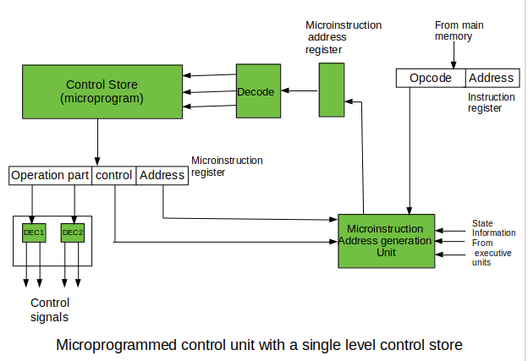
Lecture
SLIDE 4 / 10
Definition of Microinstruction
1
A microinstruction is a binary word that generates control signals for one clock cycle.
2
It represents the elementary step in the execution of a machine instruction.
3
Multiple microinstructions are sequenced to form a microprogram for one machine instruction.
4
The control unit fetches these from a dedicated control memory called the control store.
5
Each bit in a microinstruction directly activates a specific hardware component like ALU or registers.
Introduction to Control Unit and its Design - GeeksforGeeks
Chandigarh University
4 / 10
Notes:
Think of a microinstruction as a single command in a very detailed script. While a machine instruction might say 'Add A and B', the microinstruction says 'Open the ALU input gate and enable the register write'. This level of detail allows for precise timing and control over the hardware components.

Slide 5
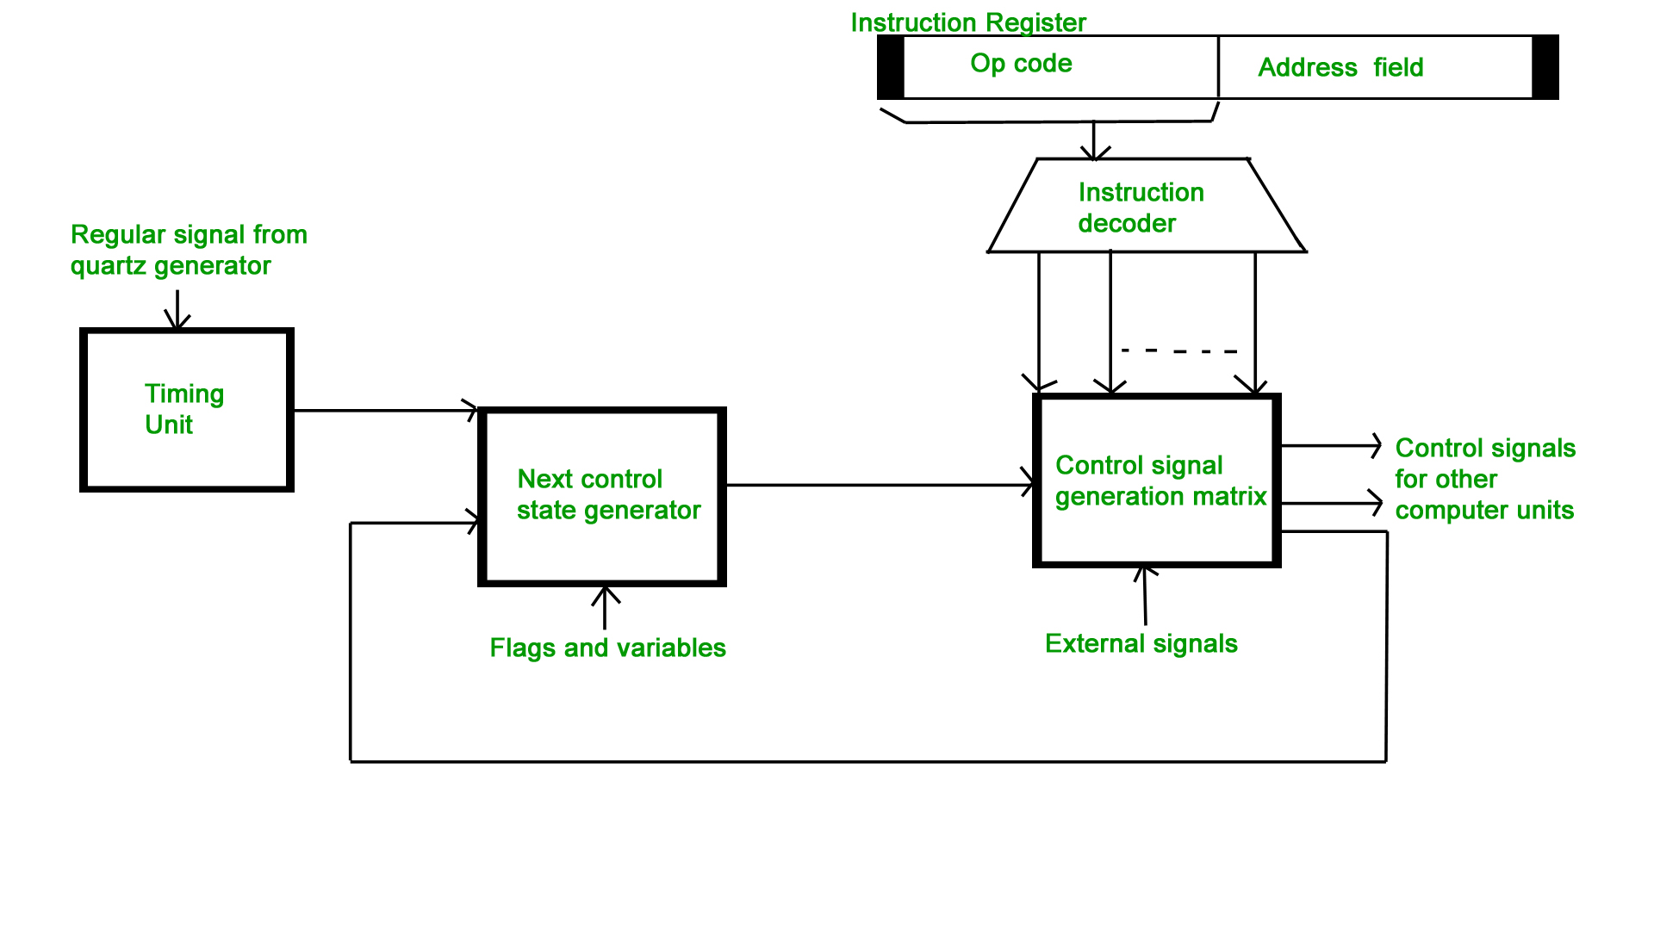
Lecture
SLIDE 5 / 10
Microinstruction Format and Fields
1
A typical microinstruction contains operation fields, next address fields, and status fields.
2
The operation field specifies which control signals to activate during the current cycle.
3
The next address field determines the location of the subsequent microinstruction in memory.
4
Status fields allow conditional branching based on processor flags like zero or carry.
5
Vertical microinstructions use a compact format with an opcode decoder for efficiency.
Hardwired and Micro-programmed Control Unit - GeeksforGeeks (source: www.geeksforgeeks.org)
Chandigarh University
5 / 10
Notes:
Let's look at the anatomy of a microinstruction. The operation field tells the hardware what to do, like 'Load Register A'. The next address field tells the control unit where to go next. If a status field is set, the sequence might branch based on a condition, similar to an 'if' statement in programming.

Slide 6
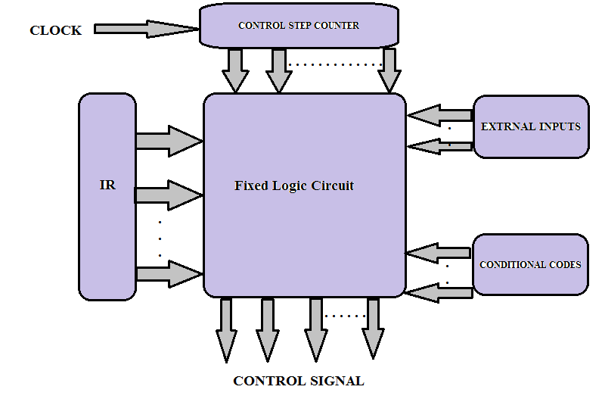
Lecture
SLIDE 6 / 10
Control Memory and Microprogram
1
Control memory stores the microprograms as a sequence of microinstructions.
2
It is typically implemented using high-speed ROM or RAM for fast access.
3
The microprogram counter (μPC) holds the address of the current microinstruction.
4
A microprogram is a sequence of microinstructions that implements one machine instruction.
5
The control unit fetches the microinstruction pointed to by the μPC on every cycle.
Hardwired and Micro-programmed Control Unit (source: vcmos.com)
Chandigarh University
6 / 10
Notes:
The control memory acts like a library of small programs. The microprogram counter is like a bookmark that tracks which microinstruction we are currently executing. When the CPU needs to execute an 'ADD' instruction, it fetches the corresponding microprogram from this memory. This separation allows the hardware to be flexible without changing the physical circuitry.

Slide 7
Lecture
SLIDE 7 / 10
Horizontal vs Vertical Microinstructions
1
Horizontal microinstructions have wide words with direct control signal bits for parallelism.
2
Vertical microinstructions use encoded opcodes to save space but require decoding logic.
3
Horizontal format offers higher speed due to fewer decoding steps per cycle.
4
Vertical format offers higher density, allowing larger microprograms in the same memory.
5
Modern designs often use a hybrid approach to balance speed and memory size.
Chandigarh University
7 / 10
Notes:
Imagine horizontal microinstructions as a direct command list where every switch is explicitly set. This is fast but uses a lot of memory. Vertical microinstructions are like shorthand codes that need a decoder to figure out the actual switches. This saves space but adds a small delay for decoding. Engineers often choose a hybrid to get the best of both worlds.

Slide 8
Worked Example
SLIDE 8 / 10
ADD Instruction
1
Machine instruction ADD R1, R2 requires three microinstructions for execution.
2
Microinstruction 1: Fetch opcode and increment program counter (μPC ← μPC + 1).
3
Microinstruction 2: Read R2 into ALU and prepare R1 for addition operation.
4
Microinstruction 3: Execute ALU addition and write result back to R1 register.
5
Total execution time is three clock cycles for this specific microprogrammed sequence.
Hardwired and Micro-programmed Control Unit - GeeksforGeeks (source: www.geeksforgeeks.org)
Chandigarh University
8 / 10
Notes:
Let's trace an ADD instruction. First, the CPU fetches the opcode. Then, it prepares the operands in the ALU. Finally, it performs the addition and stores the result. In a hardwired system, this might happen in one cycle, but in microprogrammed control, it takes three distinct steps. This illustrates the trade-off between flexibility and execution speed.

Slide 9
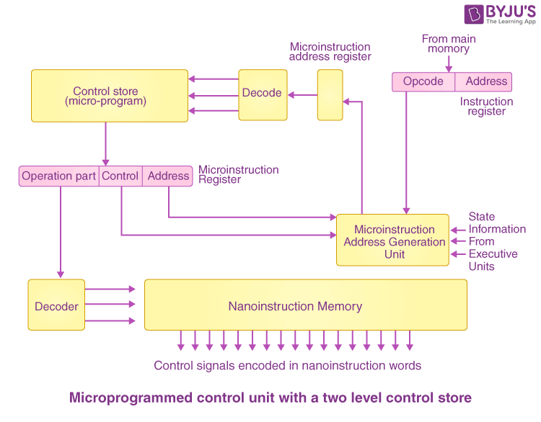
Lecture
SLIDE 9 / 10
Key Takeaways
1
Microinstructions are the elementary control signals executed in a single clock cycle.
2
They are stored in control memory and sequenced to implement machine instructions.
3
Horizontal formats offer speed while vertical formats offer memory efficiency.
4
The microprogram counter manages the flow of microinstruction execution.
5
Microprogramming simplifies control unit design and allows for easier updates.
Source: cdn1.byjus.com
Chandigarh University
9 / 10
Notes:
To summarize, microinstructions are the detailed steps that make up a machine instruction. They reside in control memory and are managed by a microprogram counter. You now understand the difference between horizontal and vertical formats and how they impact performance. This knowledge is essential for evaluating control unit designs as per our course outcome.

Slide 10
Lecture
SLIDE 10 / 10
References
COMPUTER ORGANIZATION AND DESIGN
The Hardware/Software Interface — David A. Patterson, John L. Hennessy
COMPUTER ARCHITECTURE
A Quantitative Approach — John L. Hennessy, David A. Patterson
• Computer Organization and Architecture — William Stallings
• Computer System Architecture — M. Morris Mano & Rajib Mall
• Computer Organization — Carl Hamacher, Zvonko Vranesic, Safwat Zaky
Chandigarh University
10 / 10
Notes:
These five textbooks provide the foundational knowledge for today's lecture. Stallings and Mano offer excellent explanations of control unit structures. Hamacher and the works by Patterson and Hennessy provide deeper insights into quantitative analysis and modern design. Please refer to these texts for further study on microprogramming techniques.

